Slide 1
Balance
Week 6

Slide 2
Three kinds of game balance:
Player/player
-A player’s performance is based on skill (and a little luck)
- Pacing: players have “reasonable” chance of catch-up
- Politics: skill should be more important than alliances
• Player/game
- A player shouldn’t find the game too hard or too easy to win
- Balanced resources: actions are not too “expensive”
- No dominant strategy: requires multiple play styles
• Cost/power
- A game feature’s cost must match its power
Broodwar adjusted the cost/power balance of many units

Slide 3
Player VS player – appropriately challenging
Play should ramp up from easy to harder
- Early levels are tutorial levels
- Feeling of accomplishment over time
Easy mode crucial for story-focused games
- Casual players just want to experience story
- Should have “press button to win” mode
Harder modes should be hard, not boring

Slide 4
Player VS player – Balanced resources
Sources: How a resource can increase
- Examples (player): ammunition clips, health packs
- Example (external): spawn points
Drains: How a resource can decrease
- Examples (player): firing weapon, player damage
- Examples (external): monster death
Adjust sources and sinks to “balance” economy
- Together, determine “price” of resource
- Price of resource should reflect its “power”

Slide 5
Design Problem: Pricing Resources
Underpricing
- Cheap, powerful actions
- Players favor these verbs
-Limits play variety
Examples:
- Buff spells in most RPGs
- Dragon Age cold spells

Slide 6
Design Problem: Pricing Resources
Overpricing
Expensive, weak actions
- Usage is “penalized”
- Waste of designers’ time
Examples:
- Shredder ammo in ME2
- Raise Dead in early D&D

Slide 7
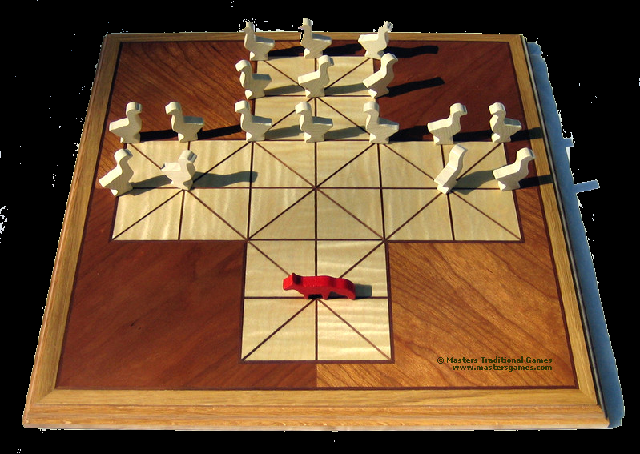
Player VS player – Fairness
Symmetric: have same start position & rules
- Easiest way to achieve fairness
- Examples: Chess, monopoly, Warcraft II
Assymetric: start & play with different rules
- Fairness harder, but more interesting
- Examples: Fox & Geese,
Starcraft
Requires user testing

Slide 8
Player VS player – Pacing
Pacing is a function of feedback
.Positive feedback: rewards player successes
.Negative feedback: punishes player successes
Positive feedback leads to snowballing
.Once player gets ahead, hard to catch up
.Opponent will quit early (redefine loss, victory)
Negative feedback leads to stalemate
.Game goes on forever without a winner
.Even worse, winner may feel arbitrary

Slide 9
Player VS player – Politics
Politics occur from player alliances
.Players “gang up” against an opponent
Problem with politics
.Turns the game into a form of “voting”
.Winner a matter of popularity, not skill
What games are susceptible to politics?
.Game must support more than two players
.Game must allow resource sharing

Slide 10
Approaches to Game Balance
• Ensure that a few random elements don’t determine outcome
- Skill matters
• Symmetry isn’t much fun
- All players have identical choices
- Features identical except for 2 parameters (power and cost)

Slide 11
Approaches to Game Balance
• Good gameplay involves a variety of interesting choices
- In Starcraft players choose from three races
- Each race has 13 types of units, 18 buildings, special powers and weaknesses
- Huge variety of strategies
• Need to insure that no race or strategy is unbeatable
- Rock - Paper - Scissors model
- Game Theory
- Lots of playtesting

Slide 12
Game Theory
What is game theory?
• Field of economics/mathematics
• Also psychology (Theory of Social Situations)
• Mathematical theory of bargaining or action selection
• Cooperative and Non-cooperative
Attempt to find a set of strategies that will maximize my payoff no matter what my opponent does
• Assumes rational players (you and the opponent)
• Assumes each player knows everything about the game
• Assumes the “payoff” is a complete measure of worth
• A strategy is a complete plan for playing the entire game

Slide 13
Prisoner’s Dilemma
Two prisoners held in separate cells. Both are offered the same deal: turn in your partner for a decreased sentence (defect). If BOTH defect then both get an increased sentence. If neither does then they both get a standard sentence (years in prison).
Confess (defect B Don’t Confess (cooperate)
Confess A=5 B=5 A=10, B=0
A
A=0, B=10
A=1, B=1
Don’t Confess

Slide 14
Prisoner’s Dilemma
What strategy should A choose to minimize jail time?
• Confess = less jail time no matter what the other person does
- Nash Equilibrium
• If both players work together each gets only 1 year
• But can you trust the other player?
Example of Public Goods Problems
• Giving to charity
• Pricing between companies
• Social Security

Slide 15
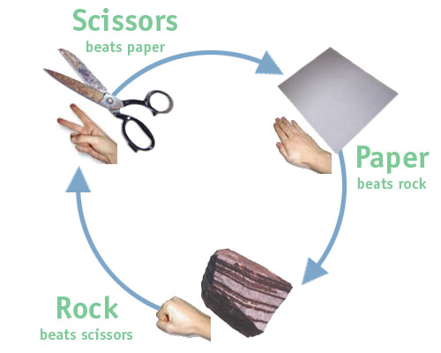
Game Theory for Game Balance
• Game theory insures that no “strategy” is dominant
• Payoff matrix
Rock Paper Scissors
Rock 0 1 -1
Paper -1 0 1
Scissors 1 -1 0
Zero Sum game
• One player’s loss is another player’s gain
No single best strategy (no dominant)
• Each column sums to zero
• Optimal strategy is a mixed strategy (choose randomly)

Slide 16
Game Theory for Game Balance
No strategy always wins.
Play is highly variable
Monotonous play is punished
Must master different styles
Play becomes psychological
What is opponent thinking?
True even if opponent an AI
Game feels random. Good?

Slide 17
Game Theory for Game Balance
What if different moves have different costs?
• Each move bets money - winner takes all (Zero Sum)
- Rock: $3, Paper: $2, Scissors: $1
Rock Paper Scissors
Rock 0 6 -2
Paper -6 0 4
Scissors 2 -4 0

Slide 18
Game Theory for Game Balance
What if different moves have different costs?
• Player B plays paper and player A plays rock
- Player B outcome: +$3
- Player A outcome: -$3
- Player B ends up $6 ahead
Optimal strategy (Nash Equilibrium) is mixed
• paper and scissors more frequently chosen
• must still choose rock occasionally

Slide 19
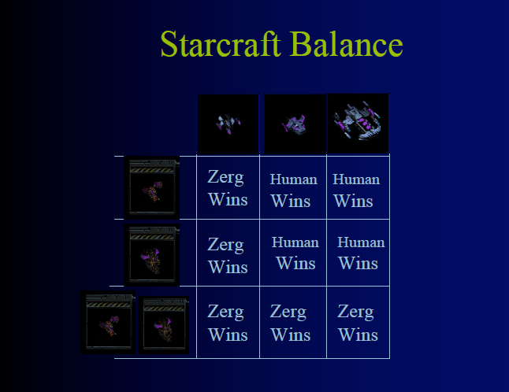
Starcraft Balance

Slide 20
Fighting game balance
Soul Caliber has 12 characters each with about 100
moves
• How to be sure no character dominates another?
Create a bunch of huge game matrices
• One matrix for each pair of characters
• Each move is a strategy
Make sure the optimal strategy is mixed in each case
• Can’t win by repeating a single “unbeatable” move

Slide 21
Game Theory and Computer Games
Classical game theory has limited applications
• Far too many “strategies”
• Usually hidden information
• Can be used for game balance
Combinatorial game theory
• Assumes sequential moves
• Still requires no hidden information
• Applies to parlor games
• Chess, Checkers, Go, Connect 4 (Solved)
• Interactive games have too many “moves” in any situation

Slide 22
Game Trees
Represent a game as a tree
• Nodes are game states
• Branches are moves
• Leaves are wins/losses
Choose next move by searching the tree
• Search n levels deep
• n depends on time available
• Evaluate board positions
• Propagate evaluations up

Slide 23
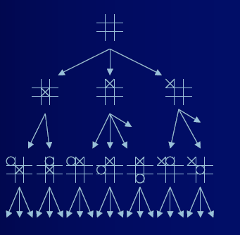

Slide 24
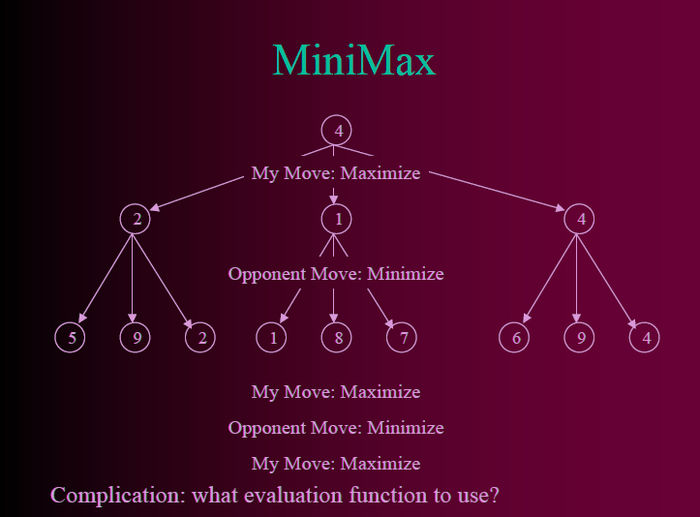

Slide 25
Making a “fun” racing game
• As designers, we want to recreate racing, not just driving around on a track
• Competition is a crucial part of that
• Need to increase likelihood of a close race
• So we could count on players getting good or, essentially, we could cheat

Slide 26
How do we cheat well?
• We have to slow the front, speed the back
• Easiest way is just with speed
• Cars in front slow down, in back, speed up
• This can be very obvious to players
• Violate “fairness” and “consistency”
• And, worse, risks removing player feel of interaction

Slide 27
Dynamic Difficulty Adjustment
• This is a fairly well studied thing
• Game monitors player behavior
• As player struggles, game changes to try and help the player through it
• If player does well, game becomes harder
• Examples?

Slide 28
Risks of DDA approaches
It seems obvious adaptive models are better for tuning an experience
• However, if a player realizes they are involved, they can exploit them
• Slowing down until the end of the race, for instance

Slide 29
Players use the Rules
Players learn to win at the provided rule-system, not the ideas in your head
They don’t learn the manual
They don’t play what you thought was cool
- If the way to “win” is to fight, you can say “hide” all you want, but they will fight
They don’t only do “reasonable” things
They poke and prod the systems, and exploit any weaknesses they can find
- If there are bugs in the rules, they will find and exploit them, if they enjoy it less

